Slide 1

Inference for the Regression Slope
Reading: 2.1
exercises: cH 2. 15b, 17bcd, 19bc
Assigned: hw 5
Producer: dr. mario
img credit: alex riegert-waters

Slide 2

Motivation
Goal: Estimate a Linear Model for the Relationship Y versus X
Strategy: Get Sample of 100 Observations and Fit Line
Question: What would happen if we got a sample of a different 100 observations, and refit the line?
$$Y=β_{0}+β_{1}X+ε$$
$$\hat{Y}=\hat{β_{0}}+\hat{β_{1}}X=3−5X$$

Slide 3

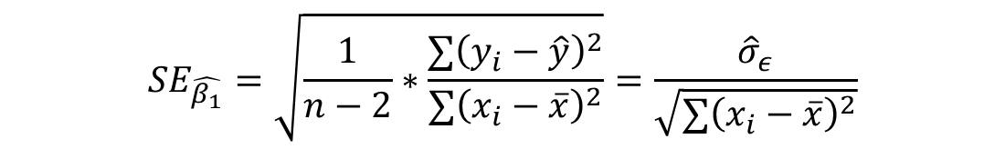
Uncertainty in Estimated Slope
Standard Error of the Slope
Measures How Much We Expect the Estimated Slope to Vary from One Sample to the Next
Measures Our Uncertainty About ${\hat{β}}_{1}$as an Estimate of $β_{1}$
$$SE_{\hat{β_{1}}}=\sqrt{\frac{1}{n−2}∗\frac{∑{\left(y_{i}−\hat{y}\right)}^{2}}{∑{\left(x_{i}−\overline{x}\right)}^{2}}}=\frac{{\hat{σ}}_{ε}}{\sqrt{∑{\left(x_{i}−\overline{x}\right)}^{2}}}$$

Slide 4


Confidence Interval for Slope
Goal: Give Range of Possible Values for $β_{1}$
Formula for 95% Confidence Interval:
Critical Value $t_{0.025, n−2}$is the 97.5 percentile on the t-Distribution with $n−2$ Degrees of Freedom
This Positive and Negative Versions of the Critical Value Divide the Appropriate t-Distribution into Middle 95% and Outside 5%
$${\hat{β}}_{1}±t_{0.025, n−2}∗SE_{\hat{β_{1}}}$$

Slide 5

t-Test for Slope
Step 1: Choose a Significance Level $α$
Assume 0.05 if Not Specified
Step 2: State Hypotheses (Null and Alternative)
$H_{0}:β_{1}=0$
$H_{a}:β_{1}≠0$
Step 3: Acquire Data and Perform Simple Linear Regression
${\hat{β}}_{1}=Estimated Slope$
${\hat{σ}}_{ε}=Standard Error of Regression$

Slide 6
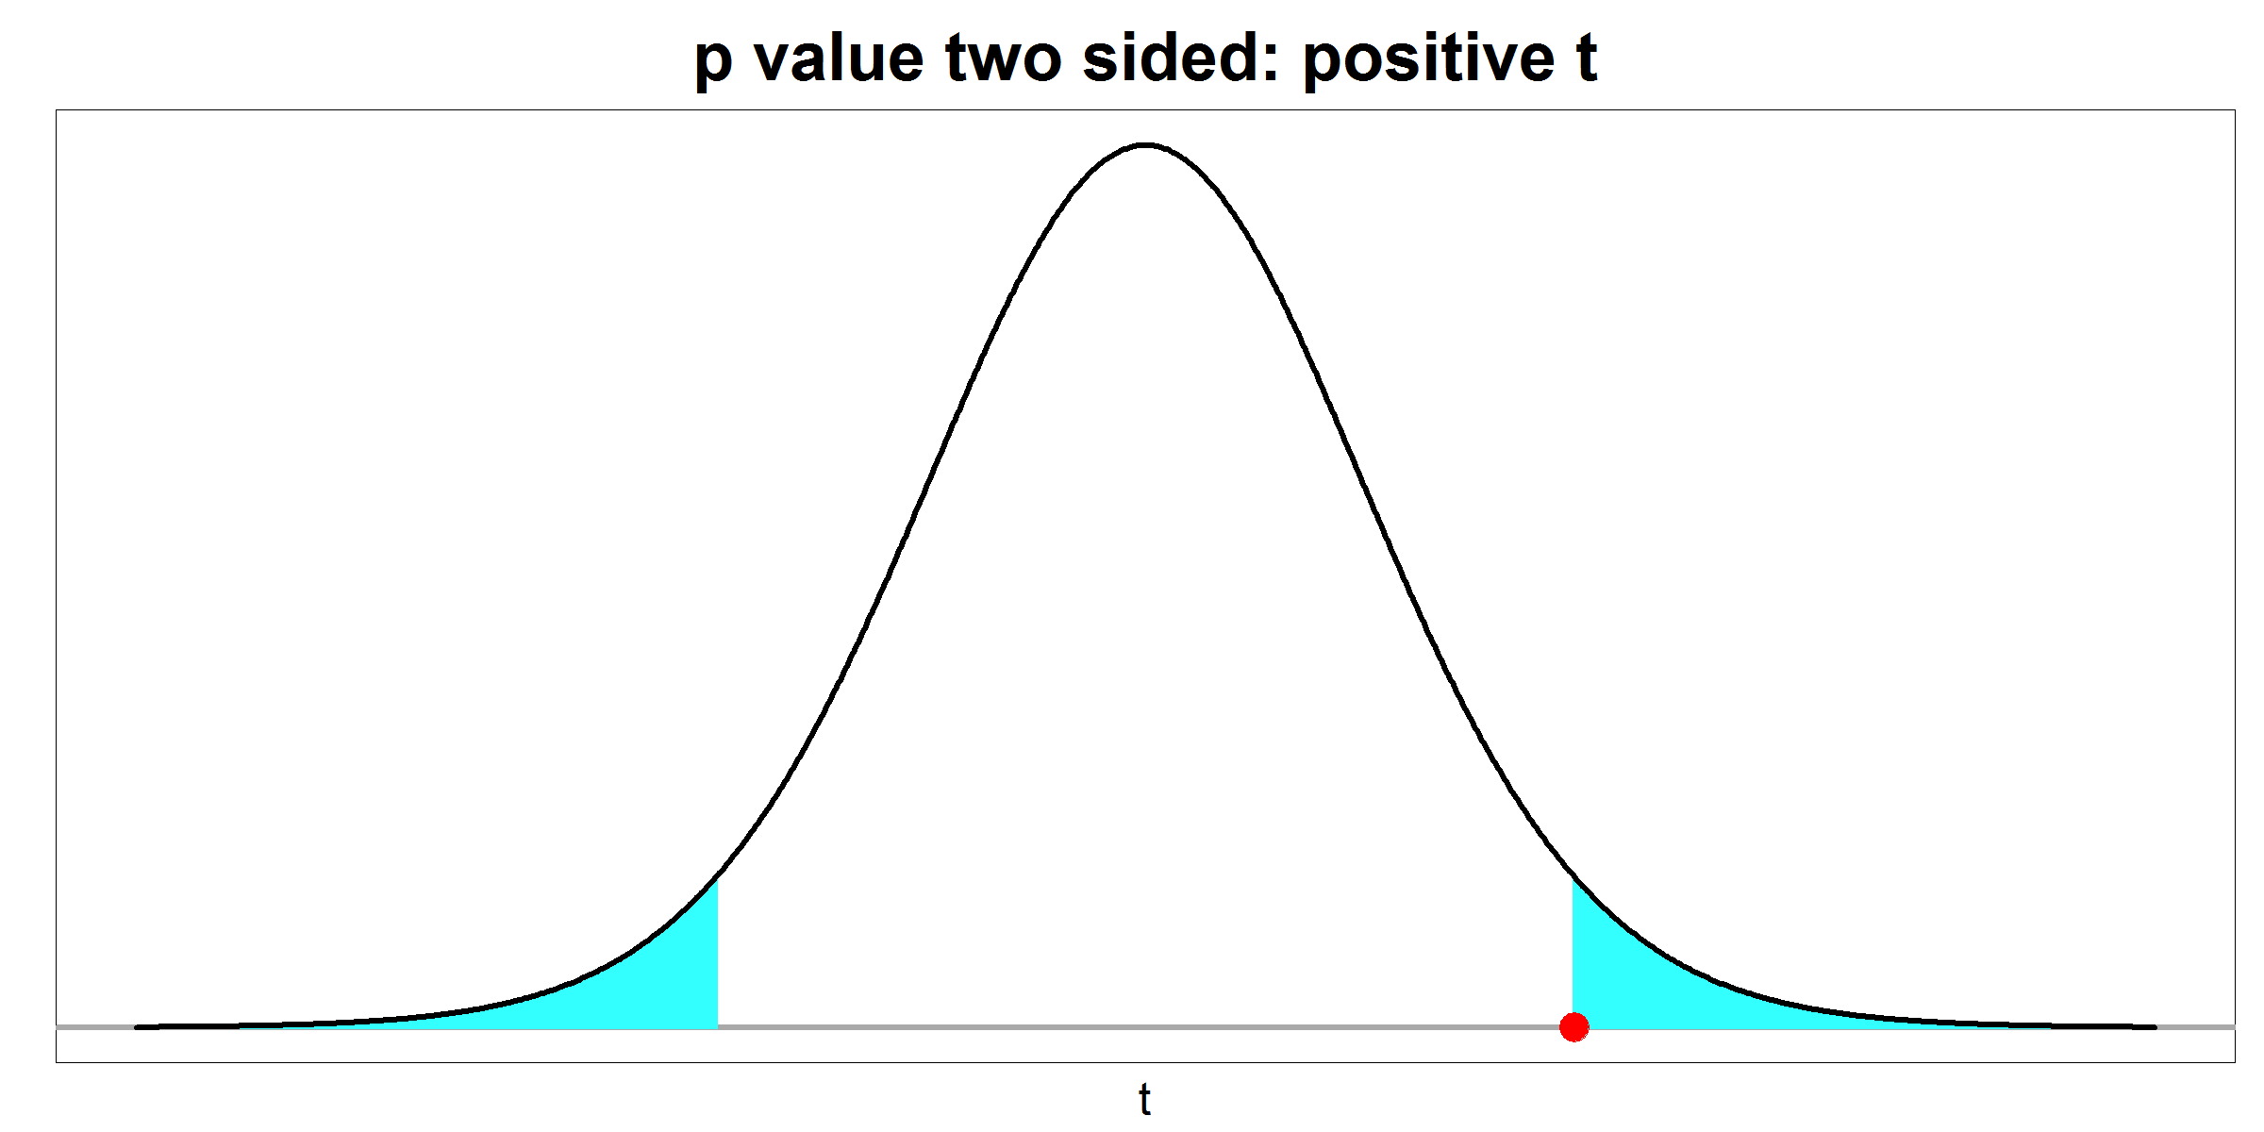



t-Test for Slope
Step 4: Test Statistic
$t^{∗}={\hat{β_{1}}}/{SE_{\hat{β_{1}}}}$
Step 5: P-value
Use t-Distribution with $n−2$ Degrees of Freedom
Two-Sided or Non-Directional
P-value = Shaded Area
$${−|t}^{∗}|$$
$${|t}^{∗}|$$

Slide 7
t-Test for Slope
Step 6: Decision
P-value < 0.05, then Reject Null and Accept Alternative
P-value > 0.05, then Fail to Reject the Null
Step 7: Interpret Results to Audience
Interpret for People with Background in Basic Math
Should Use Words that are Based off the Context of the Data
What Does “Statistically Significant” Mean to the Audience

Slide 8
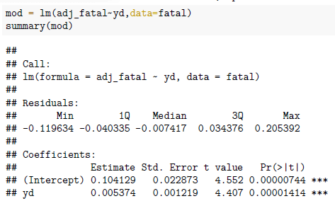
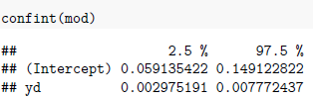
Inference for the Slope in R
The summary() function in R prints out the test statistic and p-value
The confint() function in R prints out a 95% CI for the slope

Slide 9
Conclusion
Learning What Is Classically Meant When a Person States a Predictor Variable to be “Statistically Significant”
We Can Use the Confidence Interval to Conduct a Hypothesis Test
A Confidence Interval is Superior to a Hypothesis Test
Always Supplement Your Conclusion from a Hypothesis Test with a Confidence Interval

Slide 10
Thank You
Make Reasonable Decisions

